Slide 1


COS 101: INTRODUCTION TO COMPUTER SCIENCE
Module 1 Understanding the Computer
A Comprehensive Guide to Concepts, History, and Classification
PRISCILLA EBUNOLUWA OYEBADE

Slide 2

Part 1: Basic Concepts
Foundations of Computing Technology

Slide 3


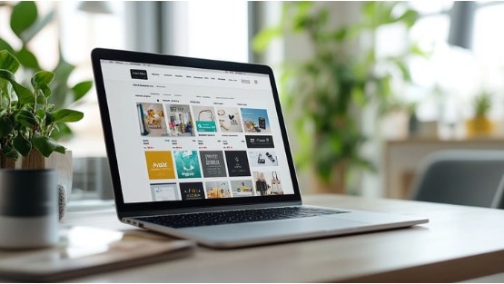
What is a Computer?
Definition
A computer is an electronic device that accepts data (input), processes it according to a set of instructions (program), produces results (output), and stores them for future use.
•
It derives from the Latin word 'computare', meaning to calculate.
•
It works on the principle of the IPOS cycle.

Slide 4



Data vs. Information
Data
Information
Raw, unprocessed facts, figures, and symbols. It has no meaning on its own.
Processed data that is organized, meaningful, and useful for decision making.
•
Examples:
•
Examples:
•
"James", 19, 5000
•
"James is 19 years old."
•
32, 55, 12
•
"Average Score: 33"

Slide 5
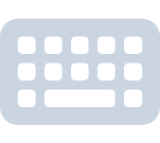
The IPOS Cycle: Input
Entering Data
Input is the process of entering data and instructions into the computer system.
Without input, a computer acts like a sleeping brain—capable but inactive.
Common Devices:
•
Keyboard (Typing)
•
Mouse (Pointing)
•
Microphone (Audio)
•
Scanner (Images)

Slide 6

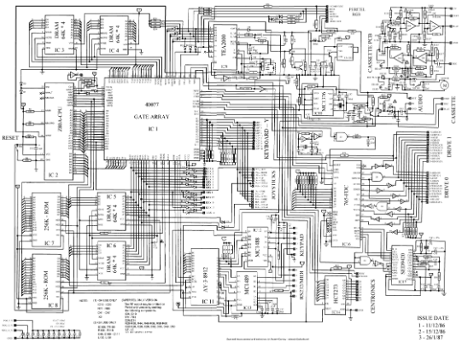
The IPOS Cycle: Processing
The Brain of the Computer
Processing involves manipulating data to transform it into information. This happens in the Central Processing Unit (CPU).
•
ALU (Arithmetic Logic Unit): Math & Logic.
•
CU (Control Unit): Traffic cop of data.
•
Registers: High-speed temporary storage.

Slide 7


The IPOS Cycle: Output
Soft Copy
Hard Copy
Intangible output displayed on a screen or played through speakers. It exists only electronically.
Tangible output printed on paper or 3D material. It is permanent and physical.
Devices: Monitors, Printers, Speakers, Projectors.

Slide 8
The IPOS Cycle: Storage
Primary Storage (RAM)
Secondary Storage (ROM/HDD)
Volatile memory. Holds data currently being used by the CPU. Data is lost when power is off.
Non-volatile. Stores data permanently even when power is off. Examples: Hard Drives, SSDs, USBs.

Slide 9


Computer Number Systems
Understanding how data is represented in computing

Slide 10

What is a Number System?
Definition
Base (Radix)
A number system is a technique used to represent and work with numbers. It is a set of values used to represent different quantities.
The total number of unique digits available in a number system.
•
Decimal (Base 10): 0, 1, 2, 3, 4, 5, 6, 7, 8, 9
•
Binary (Base 2): 0, 1

Slide 11


The Decimal System (Base 10)
The Human Standard
The decimal system is what humans use in daily life.
•
Base: 10
•
Digits: 0 through 9
•
Positional Value: Each digit's value depends on its position (units, tens, hundreds).
•
Example: $456 = (4 \times 10^2) + (5 \times 10^1) + (6 \times 10^0)$

Slide 12
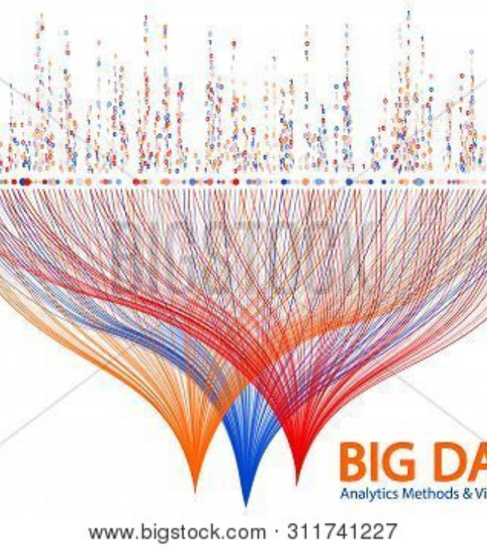
The Binary System (Base 2)
The Machine Language
Computers understand only two states: On and Off (High voltage and Low voltage).
•
Base: 2
•
Digits: 0 and 1
•
Bit: A single binary digit.
•
Byte: A group of 8 bits.

Slide 13
Octal and Hexadecimal
Octal (Base 8)
Hexadecimal (Base 16)
Uses 8 digits: 0, 1, 2, 3, 4, 5, 6, 7.
Uses 16 alphanumerics: 0-9 and A-F.
Used in early computing systems (like the PDP-8).
A=10, B=11... F=15
Widely used today to simplify binary addresses and represent colors (e.g., #FFFFFF).

Slide 14
System Comparison
Decimal (Base 10) | Binary (Base 2) | Hexadecimal (Base 16)
0 | 0000 | 0
1 | 0001 | 1
5 | 0101 | 5
10 | 1010 | A
11 | 1011 | B
15 | 1111 | F
16 | 10000 | 10

Slide 15
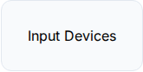
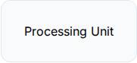
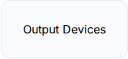
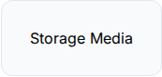
Components: Hardware
"Hardware is the part of the computer that you can kick."
— Popular Tech Saying

Slide 16
Components: Software
System Software
Application Software
Programs that run the computer hardware itself. The base layer.
Programs designed for the end-user to perform specific tasks.
•
Operating Systems (Windows, Linux)
•
Word Processors (Word)
•
Device Drivers
•
Web Browsers (Chrome)
•
Utilities (Antivirus)
•
Games & Media Players

Slide 17


Characteristic 1: Speed
Incredible Processing Power
Computers work at incredible speeds, performing millions or billions of instructions per second (MIPS/BIPS).
A task that takes a human entire year can be done by a computer in a few seconds.

Slide 18


Characteristic 2: Accuracy
Error-Free Calculation
Computers are 100% accurate. Errors in computing are usually caused by human mistakes (bad data input or bad programming).
GIGO: Garbage In, Garbage Out.

Slide 19
Diligence & Versatility
Diligence
Versatility
A computer never gets tired, bored, or distracted. It can perform the same task 10 million times with the exact same speed and accuracy as the first time.
Computers can perform widely different tasks. At one moment it's playing music, the next it's solving a complex math problem or printing a document.

Slide 20



Limitations of a Computer
No I.Q.
No Feelings
Dependency
A computer cannot think on its own. It only does exactly what it is told to do by the user or programmer.
Computers have no emotions, taste, knowledge, or experience. They don't get happy or sad.
It is fully dependent on humans for instructions and electricity for power.

Slide 21
Part 2: History of Computing
From Ancient Tools to Artificial Intelligence

Slide 22
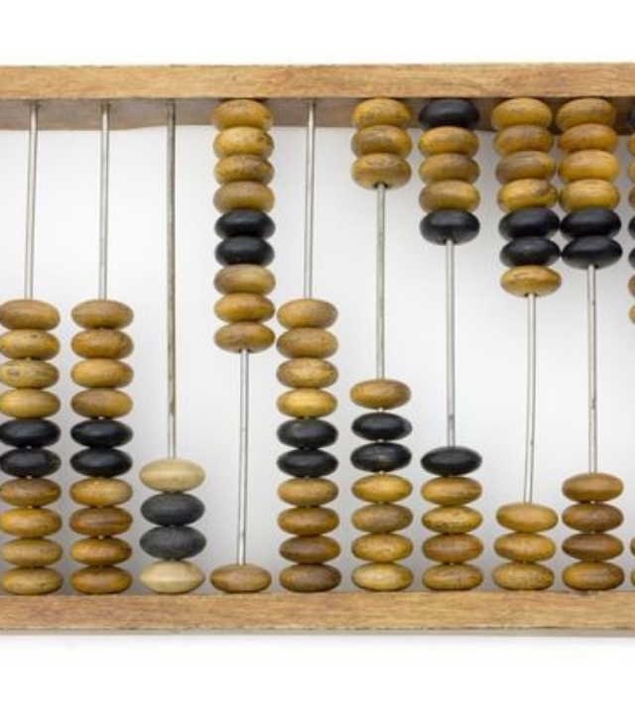
The Abacus
The First Calculation Tool
Believed to be invented by the Chinese around 4000 years ago.
It consists of a wooden rack with metal rods and beads. Sliding the beads allows for addition, subtraction, and representation of numbers.
It is still used today in some parts of the world for teaching basic math.

Slide 23
17th Century Innovations
Napier's Bones (1617)
Pascaline (1642)
Invented by John Napier. A set of ivory rods used for multiplication and division. It introduced the concept of logarithms.
Invented by Blaise Pascal at age 19. The first mechanical calculator. It used gears and wheels to perform addition and subtraction.

Slide 24
Charles Babbage
Father of the Computer
In the 1800s, he designed two machines:
•
Difference Engine: For calculating mathematical tables.
•
Analytical Engine: A general-purpose mechanical computer design that had all elements of a modern computer (Input, Store, Mill/CPU, Output).

Slide 25


Lady Ada Lovelace
The First Programmer
She was a mathematician and writer, and a friend of Charles Babbage.
She realized that Babbage's Analytical Engine could do more than just calculate numbers—it could process symbols. She wrote the very first algorithm intended to be processed by a machine.

Slide 26

Herman Hollerith
The Tabulating Machine (1890)
Designed to summarize the information stored on punched cards for the US Census.
It reduced the time required to process census data from years to months.
His company later merged with others to form IBM (International Business Machines).

Slide 27
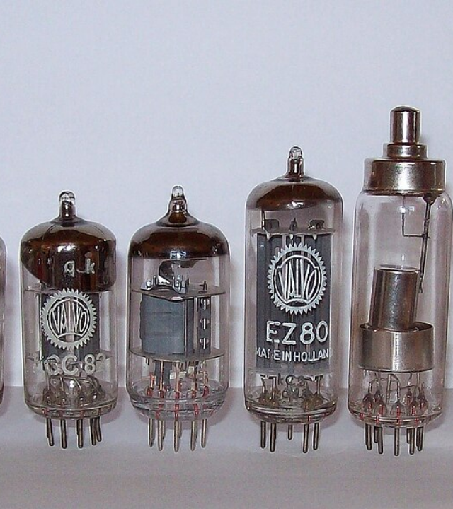
1st Generation (1940-56)
Vacuum Tubes
The first computers used vacuum tubes for circuitry and magnetic drums for memory.
Characteristics:
•
Huge in size (filled entire rooms).
•
Very expensive to operate.
•
Generated massive heat.
•
Relied on machine language (0s and 1s).

Slide 28
1st Gen Examples
ENIAC
UNIVAC
Electronic Numerical Integrator and Computer.
Universal Automatic Computer.
Weighed 30 tons, used 18,000 vacuum tubes.
The first commercial computer delivered to a business client (US Census Bureau).

Slide 29
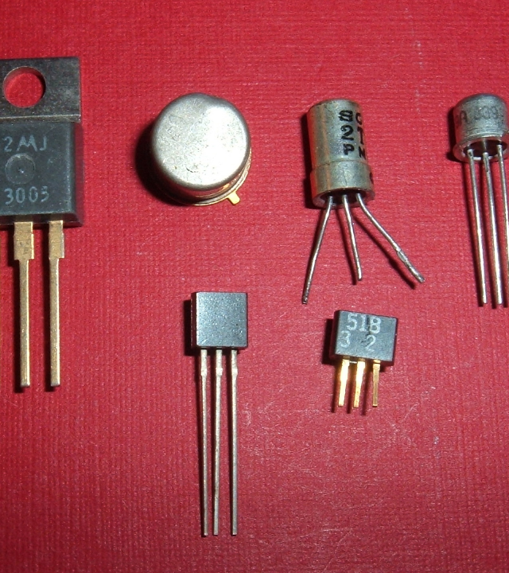
2nd Generation (1956-63)
Transistors
Transistors replaced vacuum tubes. One of the most important inventions in history.
Impact:
•
Computers became smaller.
•
Faster and more reliable.
•
More energy efficient.

Slide 30

Evolution of Language
From Binary to English-like
Second-generation computers moved from cryptic binary Machine Language to symbolic Assembly Language.
Later, high-level languages were developed, allowing programmers to give instructions in English-like words.
•
COBOL (Common Business-Oriented Language)
•
FORTRAN (Formula Translation)

Slide 31
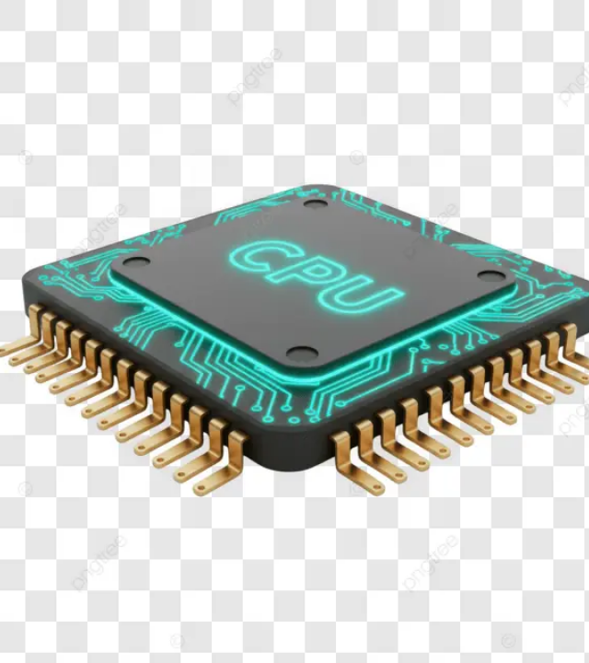
3rd Generation (1964-71)
Integrated Circuits (IC)
Transistors were miniaturized and placed on silicon chips, called semiconductors.
This drastically increased the speed and efficiency of computers.
Users began interacting via keyboards and monitors instead of punch cards.

Slide 32

The Rise of Operating Systems
Multi-tasking
For the first time, computers used an Operating System that allowed the device to run many different applications at one time with a central program monitoring the memory.
Computers became accessible to a mass audience because they were smaller and cheaper than ever before.

Slide 33
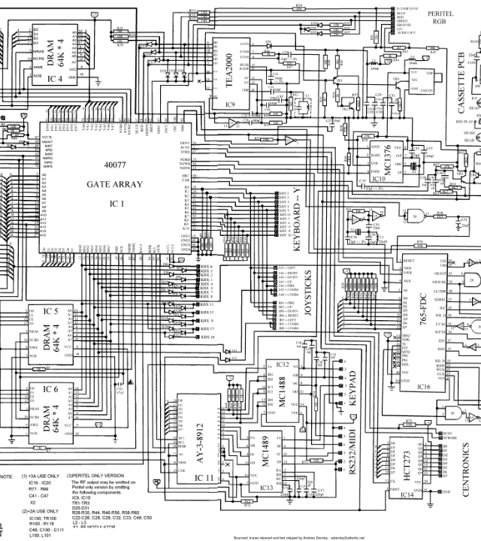
4th Generation (1971-Present)
Microprocessors
Thousands of integrated circuits were built onto a single silicon chip.
What in the first generation filled an entire room could now fit in the palm of the hand.
The Intel 4004 chip, developed in 1971, located all the components of the computer (CPU, memory, input/output controls) on a single chip.

Slide 34
The PC Revolution
Personal Computers
The Internet
In 1981, IBM introduced its first computer for the home user. In 1984, Apple introduced the Macintosh.
Fourth-generation computers also saw the development of GUIs (Graphical User Interfaces), the mouse, and handheld devices. Networked computers led to the internet.

Slide 35



5th Generation (Present & Beyond)
Artificial Intelligence
Parallel Processing
Quantum Computing
Computers that can think and learn (e.g., Voice Recognition).
Using many processors simultaneously to solve complex problems.
Computing based on quantum mechanics, offering exponential speedups.

Slide 36
Part 3: Classification of Computers
Categorizing by Purpose, Data Handling, and Size

Slide 37
Classification by Purpose
General Purpose
Special Purpose
Designed to perform a variety of tasks. You can use them to write a letter, play a game, or browse the web.
Designed to perform a specific, single task. They are often embedded systems.
Ex: Laptops, Desktops, Tablets.
Ex: ATMs, Washing Machine Controllers, Traffic Lights.

Slide 38
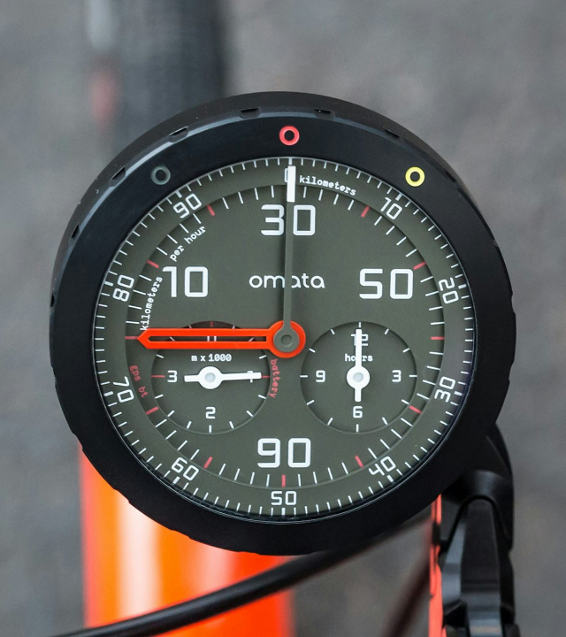
Analog Computers
They process continuous data (physical quantities that change constantly).
They do not deal with numbers directly but with measuring physical variables like voltage, pressure, temperature, or speed.
Examples: Speedometer, Mercury Thermometer, Seismometer.

Slide 39
Digital Computers
Discrete Data
They process data in discrete form (0s and 1s). They are accurate and faster than analog computers.
Everything we use today—text, sound, images—is converted into binary numbers for the digital computer to process.
Examples: All modern PCs, Smartphones.

Slide 40

Hybrid Computers
Best of Both Worlds
Hybrid computers combine the desirable features of analog and digital computers.
They are fast like analog computers and accurate like digital computers.
Use Case: ICU Hospital Monitors
Analog part measures the patient's heartbeat (continuous). Digital part displays the numbers on the screen (discrete).

Slide 41

Microcomputers
Also known as Personal Computers (PCs).
Small, inexpensive, and designed for individual use. They are based on the microprocessor technology.
•
Desktop Computers
•
Laptops / Notebooks
•
Tablets / Smartphones
•
Workstations (High-end PCs)

Slide 42

Minicomputers
Mid-Range Servers
Minicomputers are larger than microcomputers but smaller than mainframes.
They support multiple users simultaneously (from 4 to 200).
Uses: Small to medium business organizations, departmental systems, billing, and inventory tracking.
Note: The term is less common today; usually referred to as "Mid-range Servers".

Slide 43
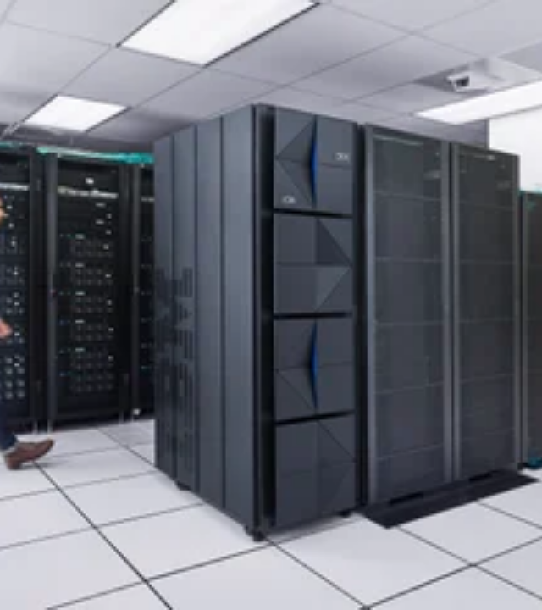
Mainframe Computers
Large, expensive, and powerful computers capable of supporting hundreds or thousands of users simultaneously.
They are known for their reliability and ability to process vast amounts of data.
Uses: Banks (ATM networks), Airlines (Reservation systems), Insurance companies.

Slide 44
Supercomputers
The fastest and most powerful computers in the world.
They are extremely expensive and are used for specialized applications that require immense mathematical calculations.
Uses: Weather forecasting, Nuclear energy research, Space exploration.
Examples: Cray, Summit, Fugaku.

Slide 45
The Future of Computing
Wearables
IoT
Cloud Computing
Computing woven into clothing or accessories (Smartwatches, AR Glasses).
Internet of Things. Everyday objects connected to the internet (Smart Fridges, Thermostats).
Moving processing and storage from local devices to massive server farms on the internet.

Slide 46

Questions?
Module 1: Understanding the Computer

Slide 47

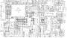
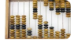
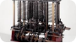
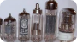
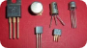
Image Sources
https://images.stockcake.com/public/1/f/e/1fec4b0a-7d31-43fe-a6c4-9fa1ac194d57_large/laptop-on-desk-stockcake.jpg
Source: stockcake.com
https://i.sstatic.net/geioP.gif
Source: stackexchange.com
http://images.computerhistory.org/revonline/images/102630015p-03-03.jpg?w=600
Source: www.computerhistory.org
https://upload.wikimedia.org/wikipedia/commons/thumb/c/cc/Babbages_Analytical_Engine%2C_1834-1871._%289660574685%29.jpg/1200px-Babbages_Analytical_Engine%2C_1834-1871._%289660574685%29.jpg
Source: wikipedia.org
https://upload.wikimedia.org/wikipedia/commons/thumb/e/e9/Elektronenroehren-auswahl.jpg/1200px-Elektronenroehren-auswahl.jpg
Source: en.wikipedia.org
https://upload.wikimedia.org/wikipedia/commons/5/5a/Transistors.agr.jpg
Source: en.wikipedia.org

Slide 48
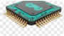
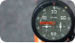
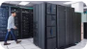

Image Sources
https://png.pngtree.com/png-vector/20250826/ourlarge/pngtree-detailed-macro-shot-of-a-futuristic-integrated-circuit-chip-with-glowing-png-image_17225581.webp
Source: pngtree.com
https://hodinkee.imgix.net/uploads/images/1509720218890-zz9s53rz70a-7f7370fa1e94f04279bf2f2864cc29b7/Omata-Hero.jpg?ixlib=rails-1.1.0&fm=jpg&q=55&auto=format&usm=12
Source: www.hodinkee.com
https://www.ibm.com/adobe/dynamicmedia/deliver/dm-aid--9440ffa4-b474-42e7-b5d1-5f56a2781a72/2021-08-18-ibm-z-forest-z-custodians-0067-fnl.jpg?preferwebp=true&width=320
Source: www.ibm.com
https://upload.wikimedia.org/wikipedia/commons/2/2a/Science_Museum_20180227_132902_%2849362732462%29.jpg
Source: wikipedia.org

